Slide 1
Key Challenges in Embracing Disability Identity
THE AFRICAN HEALTH REHABILITATION SUMMIT
Assoc. Prof. Jean Baptiste Sagahutu
University of Rwanda College of Medicine and Health Sciences

Slide 2
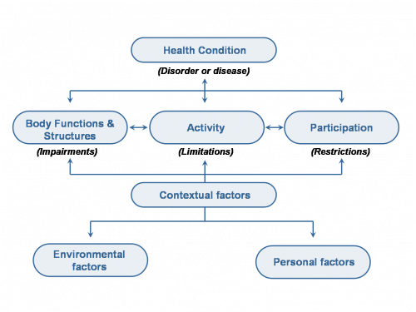
What is disability _ ICF
Persons with disabilities as those who have ‘long-term physical, mental, intellectual or sensory impairments which in interaction with various barriers may hinder their full and effective participation in society on an equal basis with others’ (UNCRPD, 2006; p.4).

Slide 3
Barriers preventing people with disabilities from fully embracing their identity
UNCRPD Articles Supporting Identity
Article 3: General Principles
  Respect for inherent dignity, individual autonomy, and freedom to make one’s own choices.
  Encourages self-determination, crucial for embracing identity.
Article 5: Equality and Non-discrimination
  Everyone is equal before the law → fosters an environment where disabled identities are valued, not marginalized (in education, health, employment,…)
Article 21: Freedom of Expression and Opinion
  Right to express cultural and personal identity without censorship.
  Includes access to communication and advocacy.

Slide 4
Barriers …..
Societal Barriers
  Ableism: This is the most fundamental barrier, comprising prejudice, discrimination, and social opposition against people with disabilities
  Attitudinal Barriers: Negative attitudes and misconceptions held by individuals and society as a whole
  Communication Barriers: Difficulties in exchanging information due to disabilities affecting hearing, speaking, reading, writing, and/or understanding
  Social Barriers: Conditions in which people are born, grow, live, learn, work, and age that contribute to decreased functioning and limit participation
Environmental Barriers: Physical Inaccessibility, Policy Barriers,
Internal Barriers: Fear of Stigma and Discrimination

Slide 5
Social stigma, discrimination, and lack of representation
Social stigma, discrimination, and lack of representation are significant interlocking barriers making it difficult for persons with disabilities to fully embrace their identity
Social Stigma
    Stereotyping
    Internalized Stigma
    Social Avoidance
Discrimination
    Direct Discrimination
    Indirect Discrimination
    Systemic Discrimination
Lack of representation: "Nothing About Us Without Us"

Slide 6
Psychological and cultural factors affecting self-acceptance
Psychological and cultural factors intricately shape an individual's journey toward self-acceptance, particularly for those navigating the complexities of disability.
These factors can either facilitate a positive integration of identity or create significant barriers:
  Psychological Factors: Self-Esteem/Self-Acceptance, Self-Concept, Coping Mechanisms
  Cultural Factors: Cultural Norms and Values, Language and Terminology, Access to Support and Resources, Intersectionality
Note:
  Self-acceptance for individuals with disabilities is a dynamic process influenced by a complex interplay of psychological and cultural factors.
  Fostering self-acceptance requires addressing internal beliefs and promoting a cultural environment that values inclusivity

